Slide 1


APPLICATION OF DIFFERENTIAL EQUATIONS
PRESENTED BY MADHURIMA RAWAT ROLL NO-$300012821042$ DATASCIENCE(CSE)
CHHATTISGARH SWAMI VIVEKANANDA TECHNICAL
UNIVERSITY

Slide 2
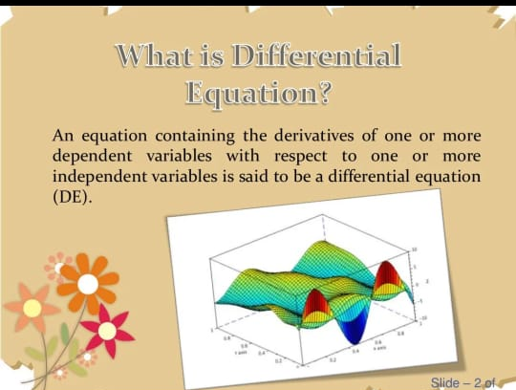
What is a Differential Equation?
A differential equation, in mathematics, can be referred to as an equation that relates to one or more functions and their derivatives.
The said Functions usually represent
physical quantities, and their derivatives
represent their rates of change.
The differential equation creates a
relationship between these two.

Slide 3
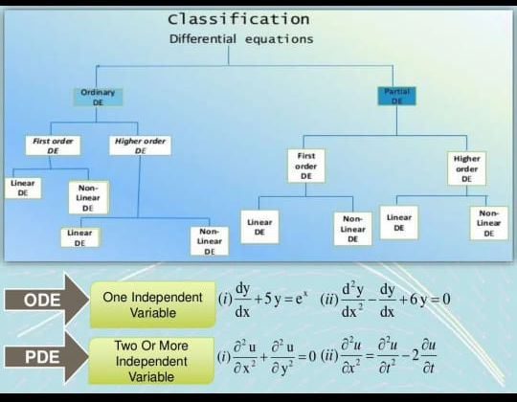
Types of Differential Equations
Differential equations can be categorized into three types:
Ordinary differential equations
Partial differential equations
Non-linear differential equations

Slide 4
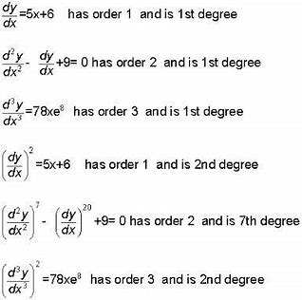
Equation Order
Differential equations are described by their order, determined by the term with the highest
derivatives. They are classified into:
First-order differential equation –
equation containing only first derivatives
2. Second-order differential equation –
equation containing the second
Derivative and so on.

Slide 5

Applications of Differential Equations
Ordinary differential equations are utilized in the real world :
To calculate the movement or flow of
electricity,motion of an object to and from like
a pendulum and to elucidate thermodynamics
concepts.
Moreover, they are used in the medical field
to check the growth of diseases in graphical representation.

Slide 6
Applications of PARTIAL Differential Equations
Partial differential equations can be used to describe a wide variety of phenomena in nature such as sound, heat, electrostatics, electrodynamics, fluid flow, elasticity, or quantum mechanics.
These physical phenomena which seem to be distinct can actually be formalized in terms of PDEs. While ordinary differential equations model one-dimensional dynamical systems, partial differential equations model multi-dimensional systems.

Slide 7
Applications of Differential Equations in Real Life
The applications of differential equations in real life are as follows:
In Physics:
Study the movement of an object like a pendulum
Study the movement of electricity
To represent thermodynamics concepts
In Medicine:
Graphical representations of the development of diseases
In Mathematics:
Describe mathematical models such as:
Population explosion
Radioactive decay

Slide 8
Applications of Differential Equations in Real Life
Geometrical applications:
To find the:
Slope of a tangent
Equation of tangent and normal
Length of tangent and normal
Length of sub-tangent and sub-normal
Physical application:
We can calculate
Velocity
Acceleration

Slide 9

Exponential Growth - Population
Let P(t) be a quantity that increases with time t and the rate of increase is proportional to the same quantity P as follows
d P / d t = k P where d p / d t is the first derivative of P, k > 0 and t is the time. The solution to the above first order differential equation is given by
P(t) = A e^{k t} where A is a constant not equal to 0. If P = P₀ at t = 0, then P₀ = A e⁰ which gives A = P₀ The final form of the solution is given by
P(t) = P₀ e^{k t} Assuming P₀ is positive and since k is positive, P(t) is an increasing exponential. d P / d t = k P is also called an exponential growth model

Slide 10

Exponential Decay-Radioactive Material
Let M(t) be the amount of a product that decreases with time t and the rate of decrease is proportional to the amount M as follows d M / d t = - k M where d M / d t is the first derivative of M, k > 0 and t is the time. Solve the above first order differential equation to obtain
M(t) = A e^{- k t} where A is non zero constant. It we assume that M = M₀ at t = 0, then M₀ = A e⁰ which gives A = M₀ The solution may be written as follows
M(t) = M₀ e^{- k t} Assuming M₀ is positive and since k is positive,M(t) is an
decreasing exponential. d M / d t = - k M is also called an exponential decay model.

Slide 11
Falling Object
An object is dropped from a height at time t = 0. If h(t) is the height of the object at time t, a(t) the acceleration and v(t) the velocity. The relationships between a, v and h are as follows: a(t) = dv / dt , v(t) = dh / dt. For a falling object, a(t) is constant and is equal to g = -9.8 m/s.
Combining the above differential equations, we can easily deduce the following equation:
d ² h / dt ² = g
Integrate both sides of the above equation to obtain dh / dt = g t + v₀ Integrate one more time to obtain h(t) = (1/2) g t² + v₀ t + h₀ The above equation describes the height of a falling object, from an initial height h₀ at an initial velocity v₀, as a function of time.

Slide 12
Newton's Law of Cooling
It is a model that describes, mathematically, the change in temperature of an object in a given environment. The law states that the rate of change (in time) of the temperature is proportional to the difference between the temperature T of the object and the temperature Te of the environment surrounding the object. d T / d t = - k (T - Te)
Let x = T - Te so that dx / dt = dT / dt Using the above change of variable, the above differential equation becomes d x / d t = - k x
The solution to the above differential equation is given by x = A e ^{- k t} substitute x by T - Te T - Te = A e ^{- k t} Assume that at t = 0 the temperature T = To To - Te = A e ⁰ which gives A = To - Te The final expression for T(t) i given by T(t) = Te + (To - Te)e ^{- k t} This last expression shows how the temperature T of the object changes with time.

Slide 13
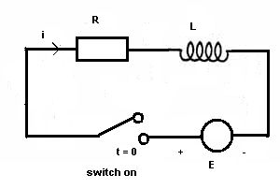
RL circuit
Let us consider the RL (resistor R and inductor L) circuit shown above. At t = 0 the switch is closed and current passes through the circuit. Electricity laws state that the voltage across a resistor of resistance R is equal to R i and the voltage across an inductor L is given by L di/dt (i is the current). Another law gives an equation relating all voltages in the above circuit as follows: L di/dt + Ri = E , where E is a constant voltage. Let us solve the above differential equation which may be written as: L [ di / dt ] / [E - R i] = 1 which may be written as - (L / R) [ - R d i ] / [E - Ri] = dt Integrate both sides - (L / R) ln(E - R i) = t + c , c constant of integration. Find constant c by setting i = 0 at t = 0 (when switch is closed) which gives c = (-L / R) ln(E)

Slide 14
RL circuit
Substitute c in the solution - (L / R) ln(E - R i) = t + (-L/R) ln (E) which may be written (L/R) ln (E)- (L / R) ln(E - R i) = t ln[E/(E - Ri)] = t(R/L) Change into exponential form [E/(E - Ri)] = e
^{t(R/L)} Solve for i to obtain i = (E/R) (1-e^{-Rt/L}) The starting model for the circuit is a differential equation which when solved, gives an expression of the current in the circuit as a function of time.

Slide 15
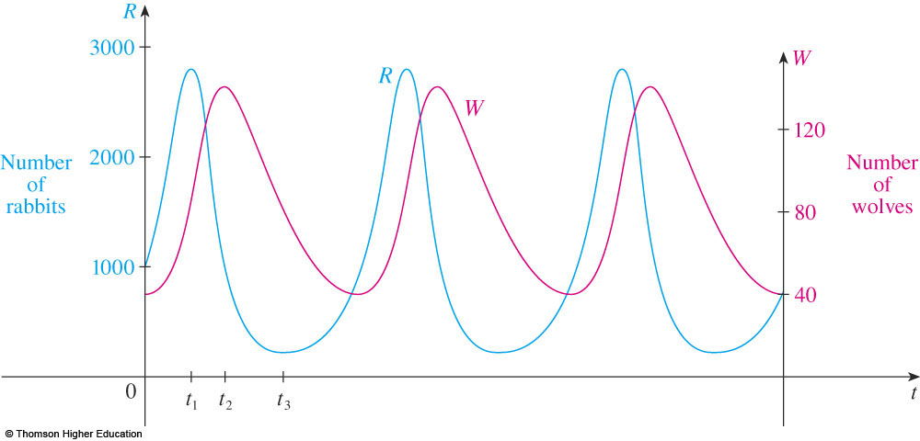
LOTKA-VOLTERRA EQUATIONS
We let R(t) be the number of prey (R for rabbits) and W(t) be the number of predators (W for wolves) at time t.
In the absence of predators, the ample food supply would support exponential growth of the prey, that is,
where k is a positive constant.
In the absence of prey, we assume that the predator population would decline at a rate proportional to itself, that is,
where r is a positive constant.

Slide 16
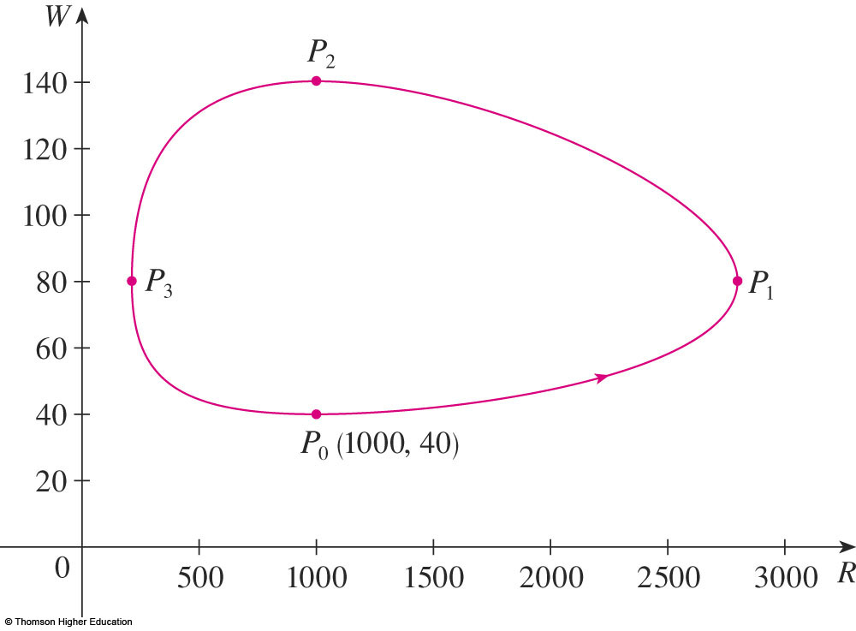
LOTKA-VOLTERRA EQUATIONS
They were proposed as a model to explain the variations in the shark and food-fish populations in the Adriatic Sea by the
Italian mathematician Vito Volterra (1860–1940).
These equations are known as the
predator-prey equations, or the Lotka-Volterra equations.

Slide 17
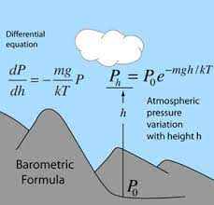

Some other applications

Slide 18
APPLICATION OF DIFFERENTIAL EQUATIONS
CODING PROGRAMS IN PYTHON PROGRAMMING LANGUAGE

Slide 19
CODE FOR SOLVING DIFFERENTIAL EQUATION
import numpy as np
from scipy.integrate import odeint
import matplotlib.pyplot as plt
# function that returns dy/dt
print("Solving and plotting graph for Differential Equation in Python.")
def model(y,t):
k = 0.3
dydt = -k * y
return dydt
# initial condition
y0 = 5
# time points
t = np.linspace(0,20)
# solve ODE
y = odeint(model,y0,t)
# plot results
plt.plot(t,y)
plt.xlabel('time')
plt.ylabel('y(t)')
plt.show()

Slide 20
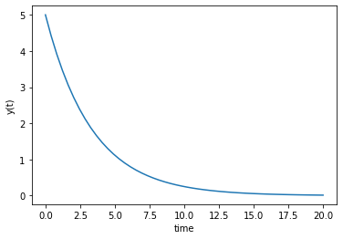
OUTPUT OF THE CODE
Solving and plotting graph for Differential Equation in Python.

Slide 21
THANK YOU FOR LISTENING TO ME
ANY QUESTIONS

